Slide 1

COVID-19 Pandemic in the African Region Epi situation update as of 02/04/2020
Notes:
This slide requires update including adding the third graphics.
It is intended to show trend among cases according to exposure history. First graph shows trend, the map shows movements and importation, the third chart will be a checker board chart showing actual number of people from country of exposure to country of improtation

Slide 2

Disclaimer
The following slides are not final and are produced solely for the purposes of informing operations. As investigations are ongoing, all data are subject to verification and change. Not all analyses are updated daily, and additional analyses will be added/removed depending on operational needs at the time of production.
All information in this slide deck should be treated as confidential and provisional , and should not be shared or used for any outward facing products.

Slide 3

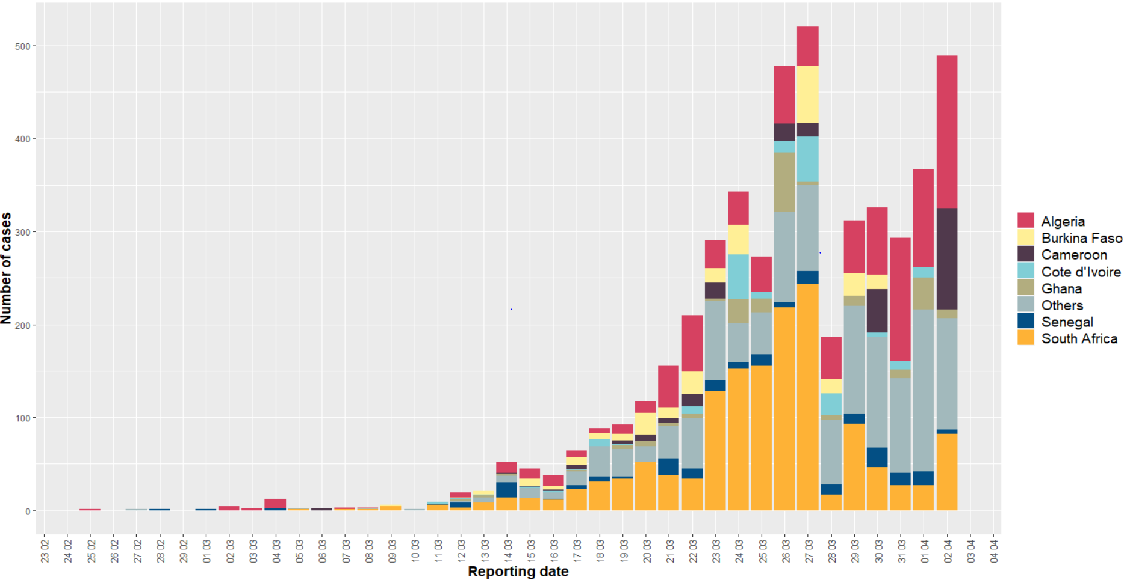
Overview (02/04/2020, African region)
Confirmed cases:
Countries: 16 vs 25 on 01/04
New: 489 VS 367 on 01/04
Cumulative: 4 827
Deaths:
New: 30 in 4 countries (25 in Algeria)
Cumulative AFRO: 162
CFR: 3.5 %
Countries affected:
New: 01 (Malawi)
Cumulative: 43

Slide 4
Overview (02/04/2020, African region)
New cases reported during last 2 days
Country | 01/04/2020 | 02/04/2020 | Cumul 2 days
Algeria | 106 | 164 | 270
Angola | 1 | 3 | 4
Benin | 7 | 0 | 7
Cameroon | 0 | 109 | 109
CAR | 2 | 0 | 2
Congo | 0 | 19 | 19
Cote d'Ivoire | 11 | 0 | 11
DRC | 14 | 11 | 25
Eq Guinea | 1 | 0 | 1
Eritrea | 5 | 0 | 5
Ethiopia | 0 | 5 | 5
Ghana | 34 | 9 | 43
Guinea | 9 | 21 | 30
Kenya | 22 | 29 | 51
Liberia | 3 | 0 | 3
Country | 01/04/2020 | 02/04/2020 | Cumul 2 days
Madagascar | 6 | 6 | 12
Malawi | 0 | 3 | 3
Mali | 3 | 0 | 3
Mauritius | 11 | 15 | 26
Mozambique | 2 | 0 | 2
Namibia | 2 | 0 | 2
Niger | 40 | 0 | 40
Nigeria | 35 | 0 | 35
Rwanda | 7 | 2 | 9
Senegal | 15 | 5 | 20
Sierra Leone | 1 | 0 | 1
South Africa | 27 | 82 | 109
Tanzania | 1 | 0 | 1
Togo | 2 | 3 | 5
Zambia | 0 | 3 | 3
Total | 367 | 489 | 856
Nb countries | 25 | 16 | 30

Slide 5
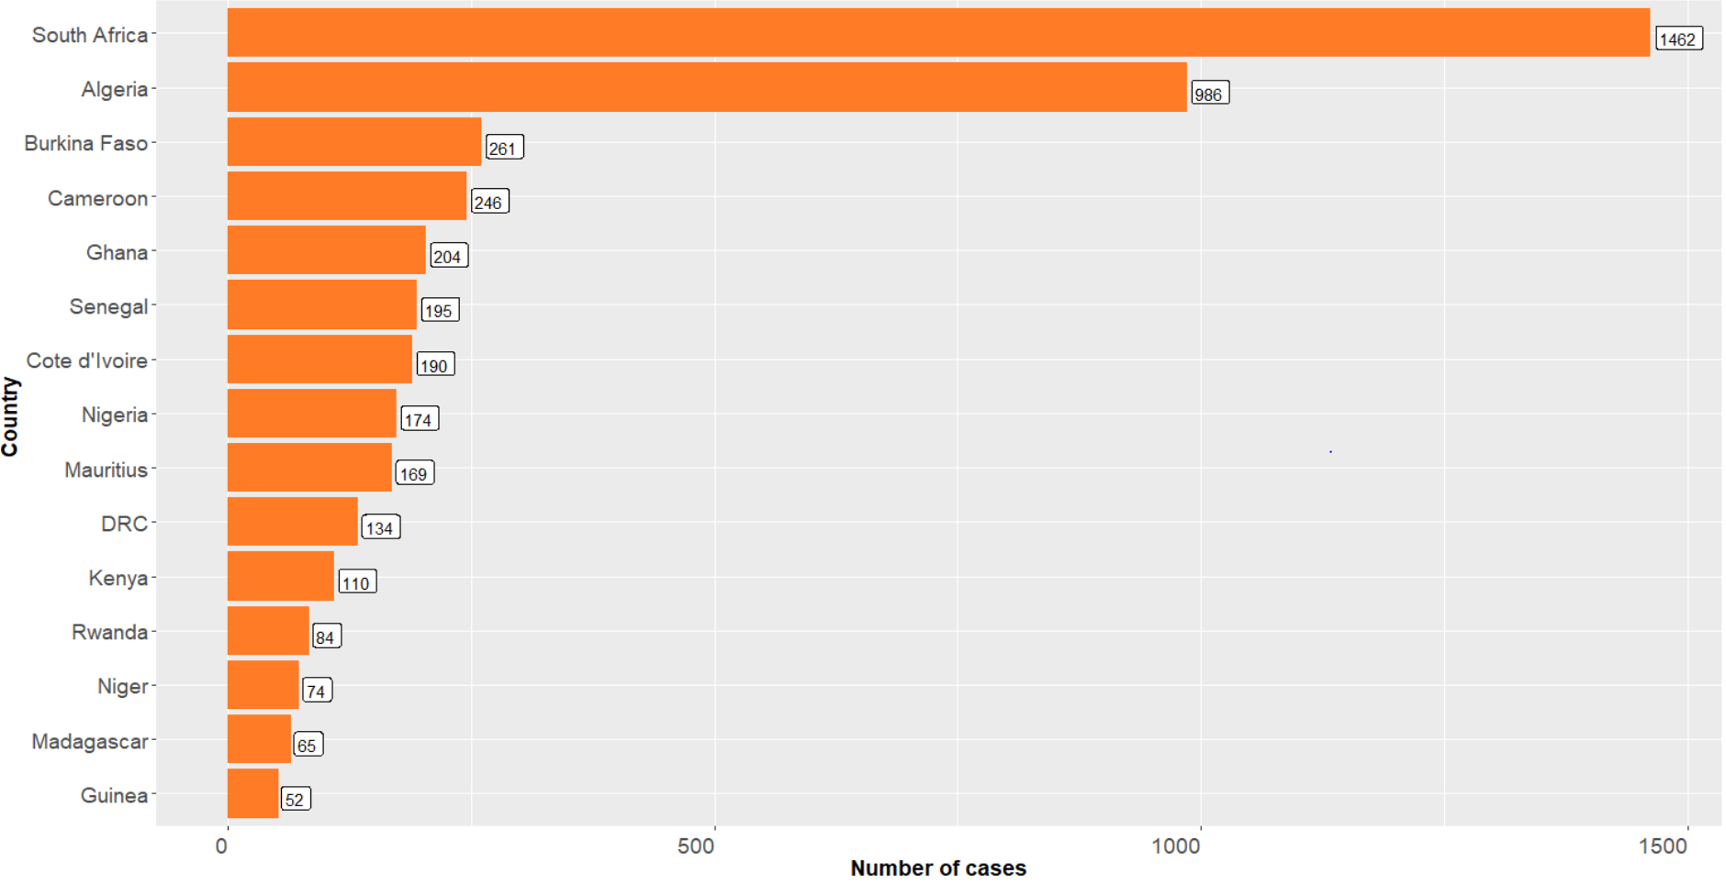
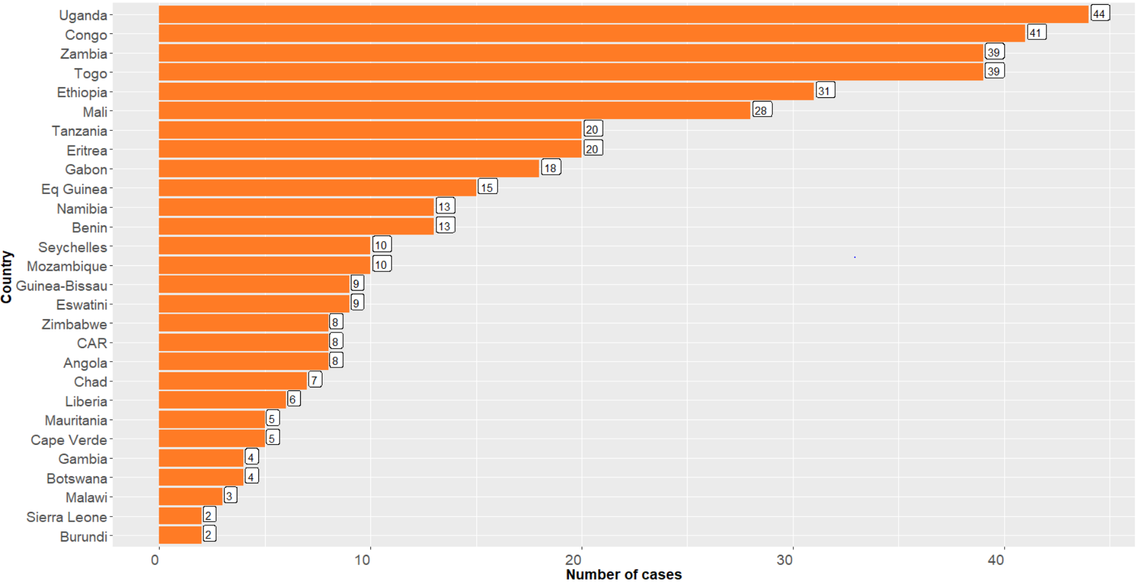
Overview (01/04/2020, African region)
Cumulative cases – countries with 50+ confirmed cases
Cumulative cases – countries with less than 50 confirmed cases

Slide 6
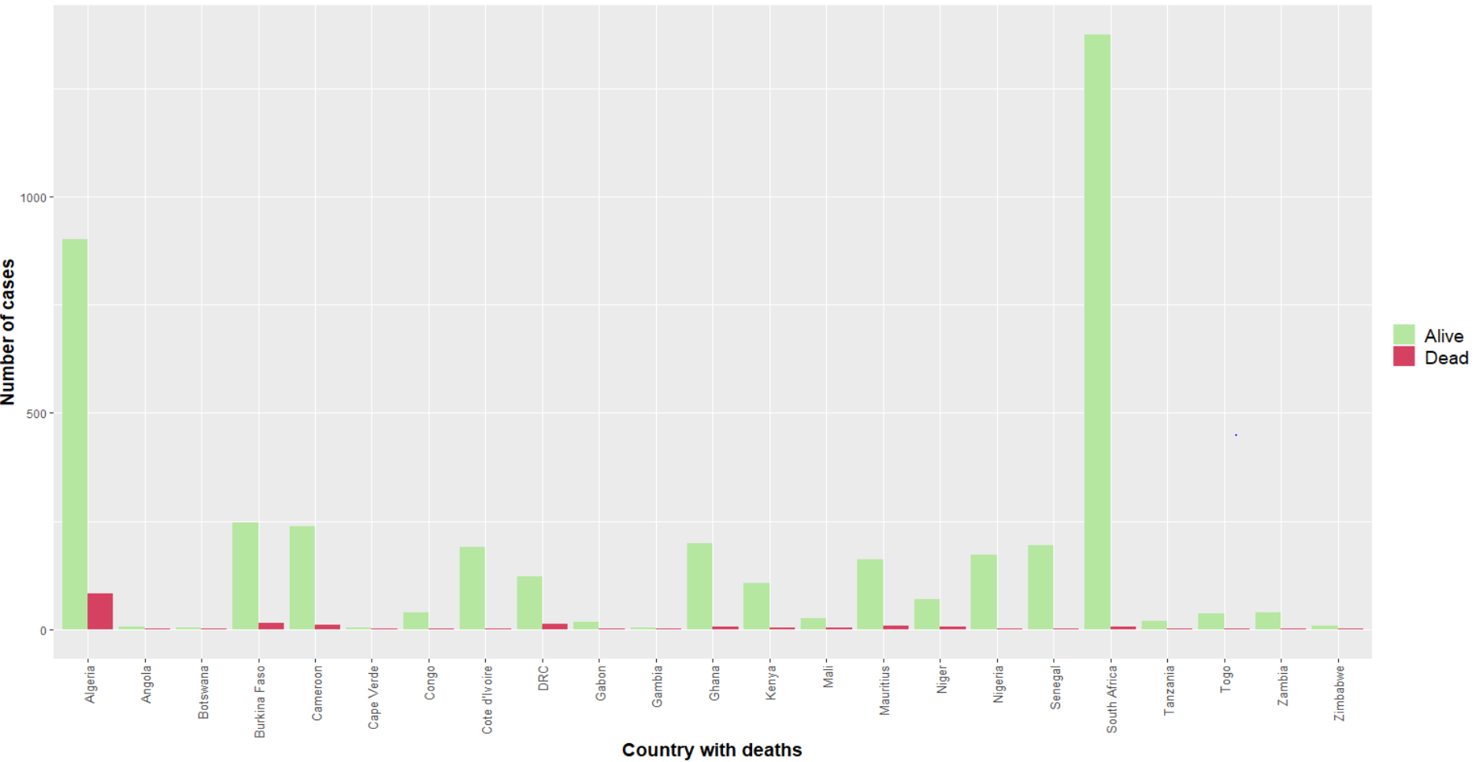
23/43 countries have reported at least one death

Slide 7
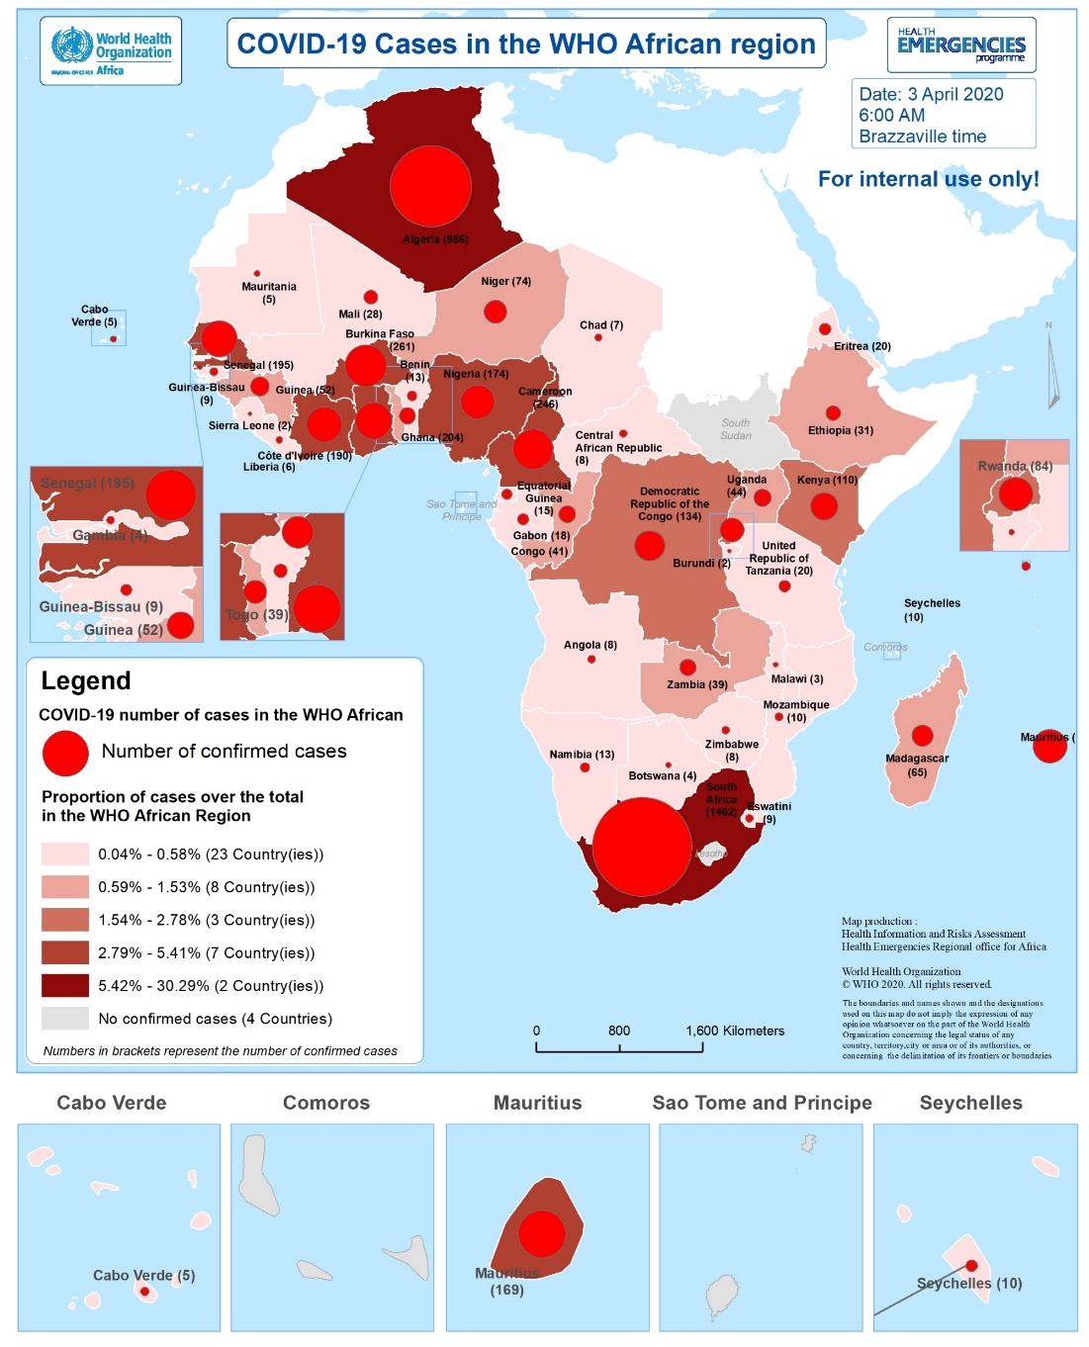
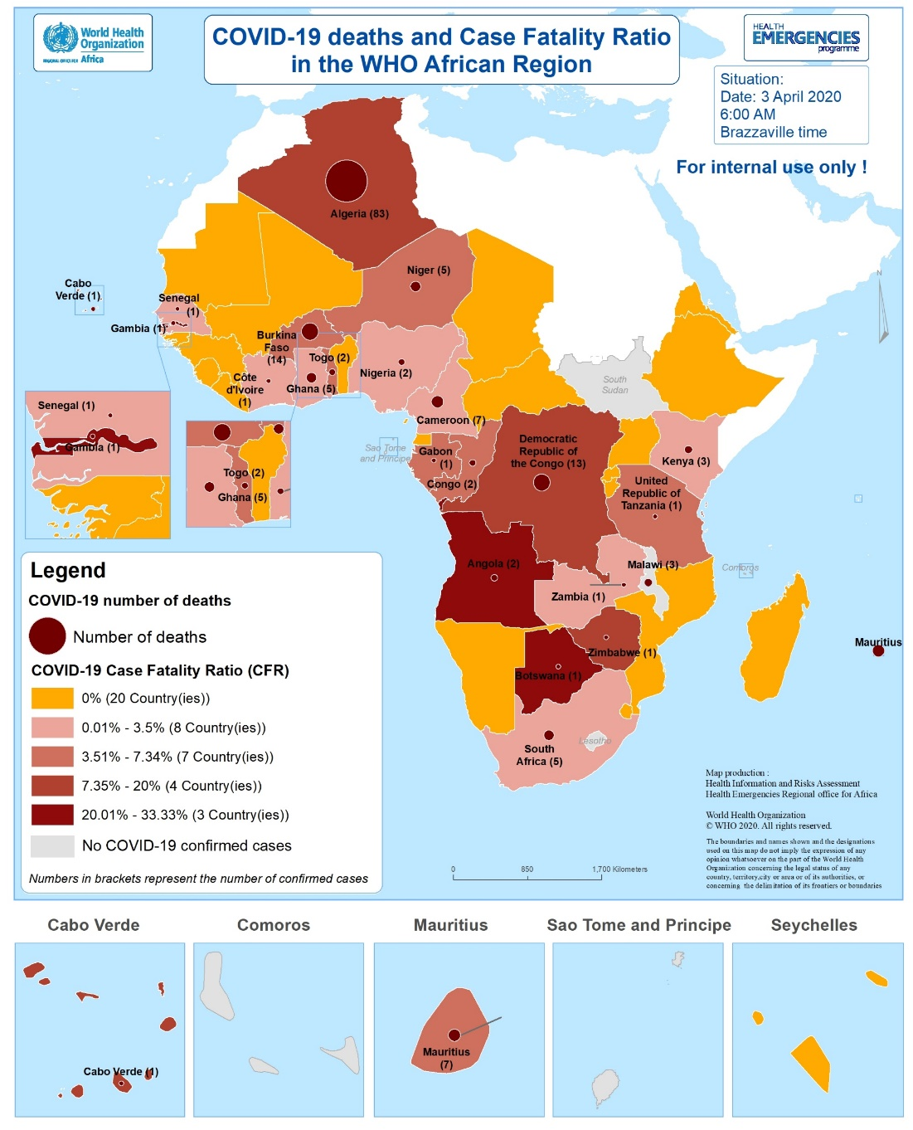
Geographical distribution of confirmed cases and deaths

Slide 8
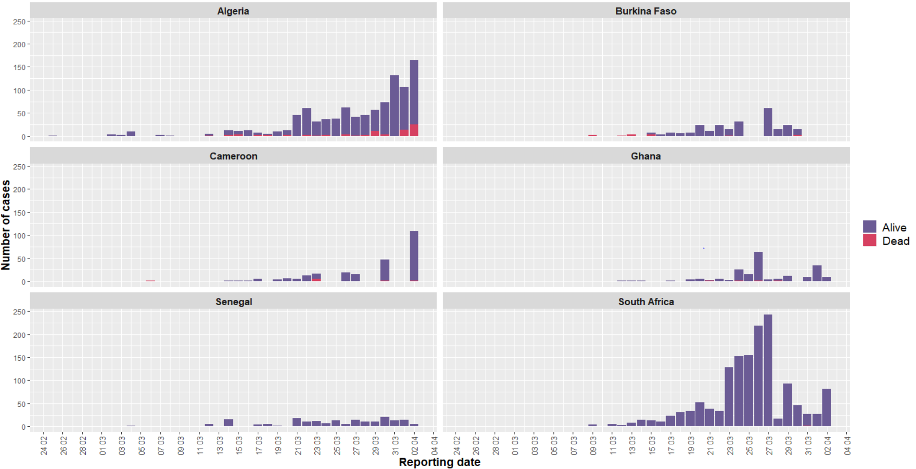
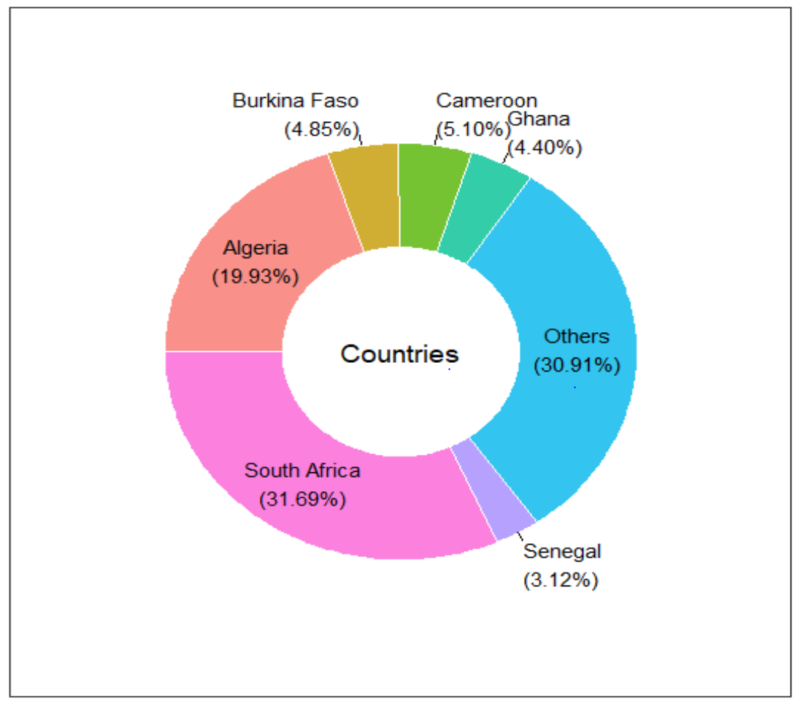
Distribution of cases over time for Top6 countries
CFR=8.4%
CFR=5.4%
CFR=2.8%
CFR=2.5%
CFR=0.5%
CFR=0.3%

Slide 9
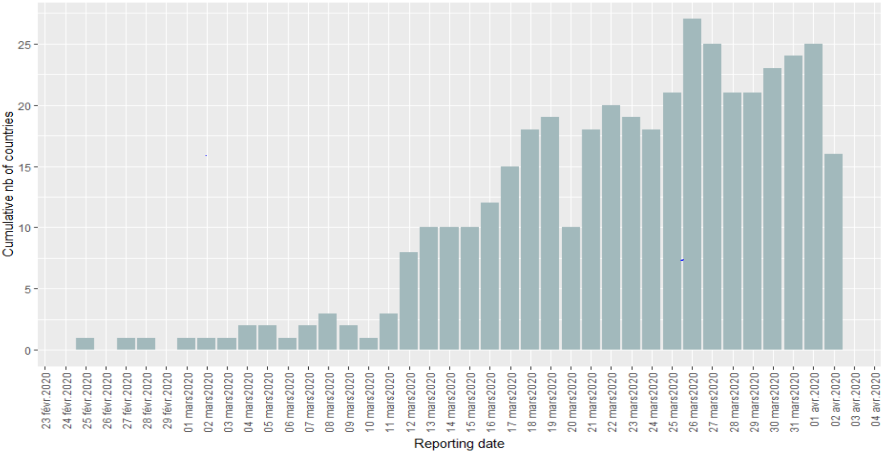
Distribution of number of countries reporting cases per day

Slide 10
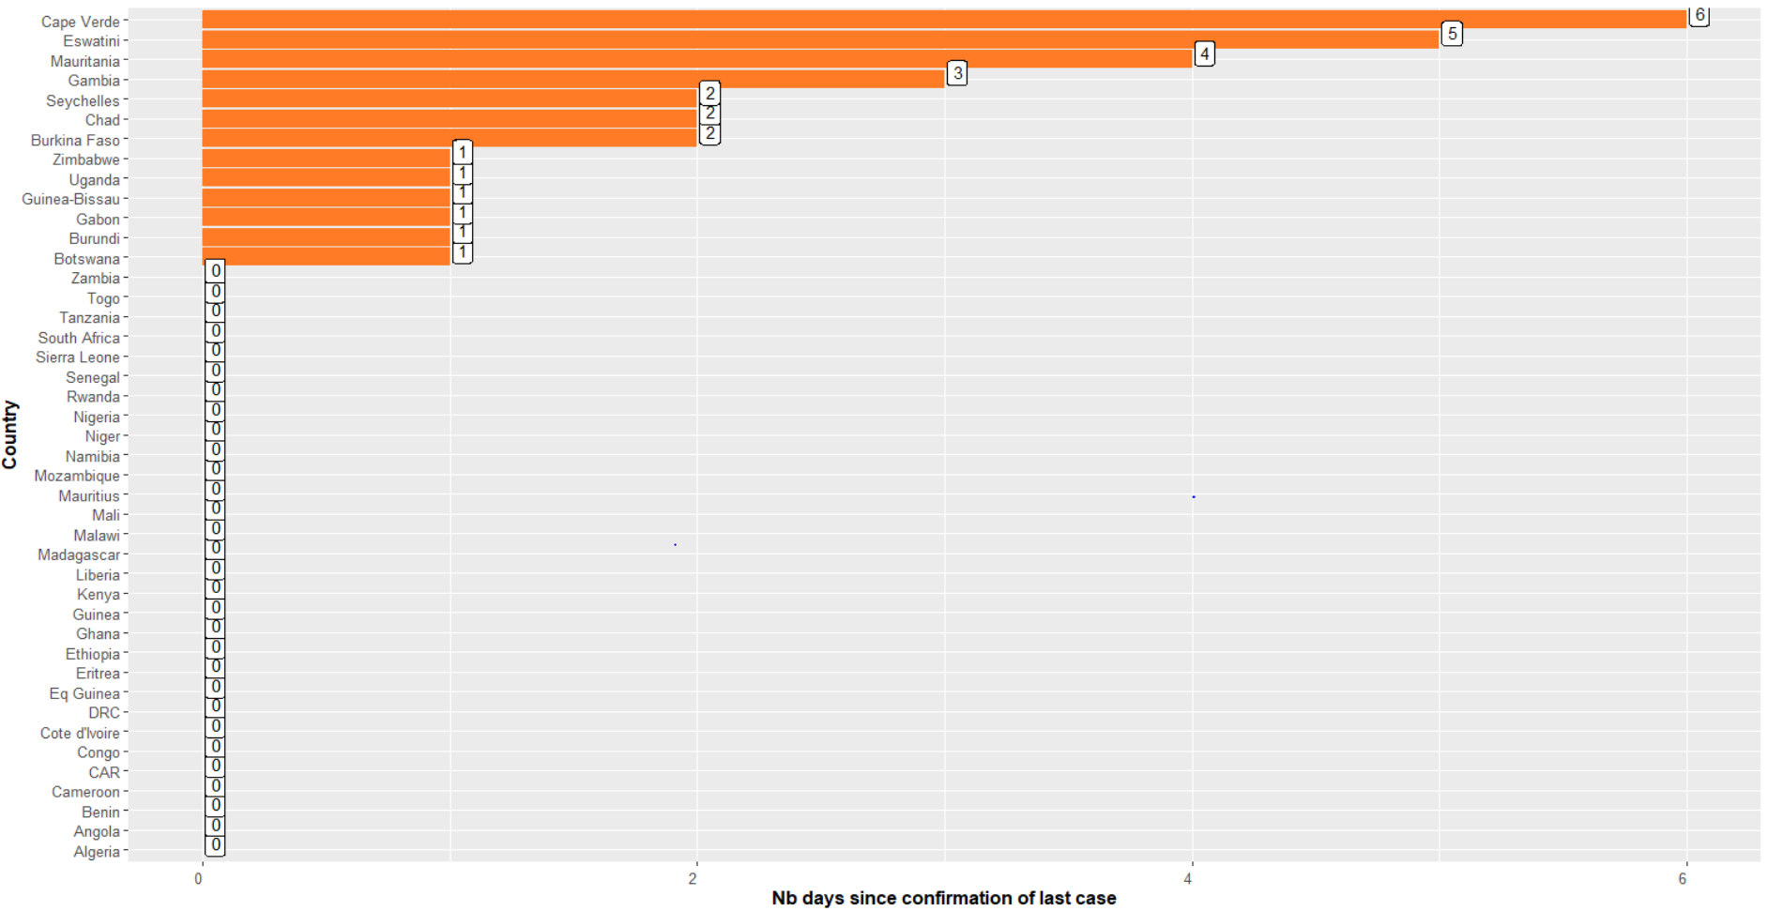
Number of days since last notification of a confirmed case per country
4 countries (9%) Vs 6 on 01/04

Slide 11
Summary
The COVID-19 epidemiological situation in the region still concerning: 30 countries reported cases during the last 48 hours, 4 827 cumulative number of confirmed cases recorded including 162 deaths;
countries South Africa, Algeria, Burkina Faso, Senegal and Cameroon among Top 6 among the top 6 countries in term of cumulative number of confirmed cases;
Highest number of new confirmed cases during the last 48 hours reported by Algeria (270), South Africa (109), Cameroon (109), Kenya (51) and Ghana (43).
23 countries / 43 (53%) have reported at least one death of a confirmed case.

Slide 12
Summary
Situation related to data sharing unchanged;
Continued monitoring preparedness activities in the 5 countries with no confirmed case reported: critical.

